Slide 1
What is an API?
An API, or Application Programming Interface, is a set of rules and protocols that allows different software applications to communicate with each other. It defines the methods and data formats that applications can use to request and exchange information
In simpler terms, an API is like a messenger that takes your request (e.g., asking for specific data or functionality) to a system (like a server or database), gets the response, and delivers it back to you.

Slide 2
What is a RESTful API?
"Representational State Transfer" (REST)
Representational: In REST, resources are represented in various formats such as JSON, XML, or HTML. These representations convey the current state of the resource(A resource can be anything like document, image, database record, or a collection of other resources). For example, a user resource might be represented as JSON containing attributes like name, email, and age.
State: The state refers to the data associated with a resource at a particular point in time. It can be modified through interactions with the API. For instance, updating a user's profile or adding a new item to a shopping cart changes the state of those resources.
Transfer: REST involves transferring these representations of resource state between the client and server over a network using standardized communication protocols such as HTTP

Slide 3
Furthermore, It is a stateless, client independent API for exchanging data
Stateless: each request from a client to a server is independent and unrelated to previous requests. The server does not retain any information about past requests from the same client.
Client : a web browser, mobile app, or any device making requests
Server : which stores and manages resources, responding to client requests.
Client independent: The client does not need to know how the server is storing or processing data. The server does not need to know about the specific client or its functionality.

Slide 4
What is GraphQL?
It is a stateless, client independent API for exchanging data with query flexibility
Why we need GraphQL?
For eg, if we need to fetch a post we hot GET/post. But what if we need only certain details of that post like ID.
So GraphQl helps avoid getting such redundant data and get only specific data.

Slide 5
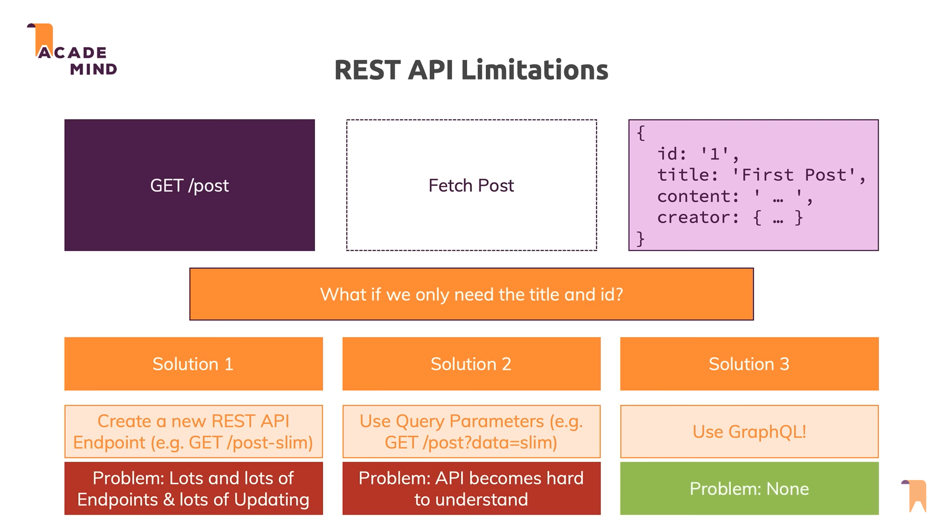

Slide 6
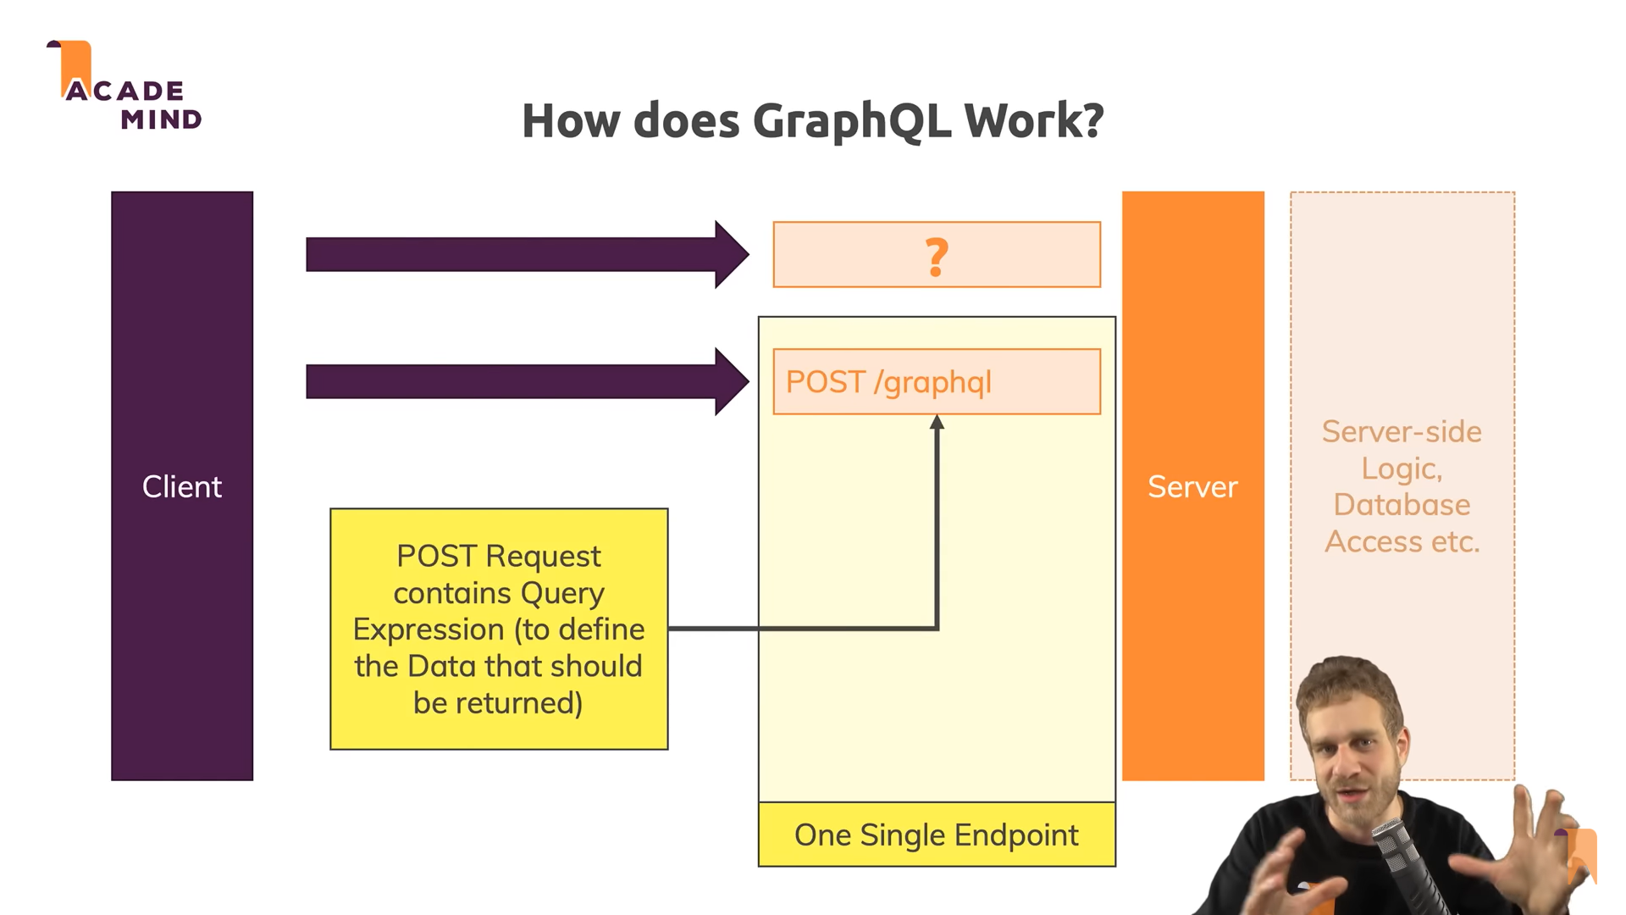
Since POST request has request body, we are using post always to define query expressions
We can also technically use PATCH method though. But conventionally we use POST
Also, it has single end point(can be anything)

Slide 7
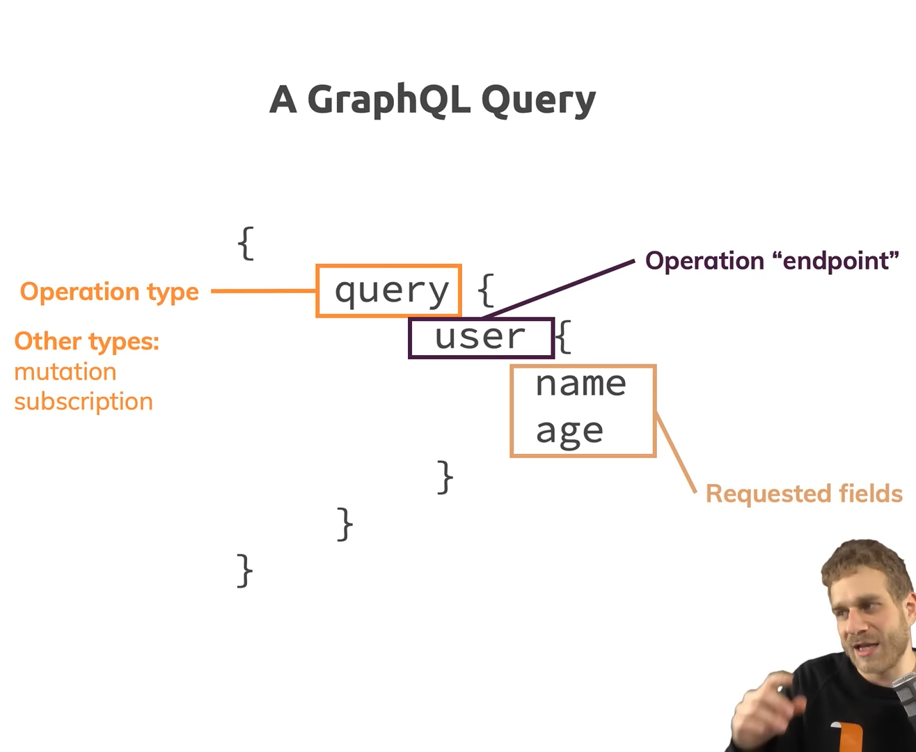
Query: to get data
Mutation: to modify data (POST, PUT, PATCH, DELETE)
Subscription: when we want to push some updates from server to client

Slide 8
Project setup
npm init: is used to initialize a new Node.js project and manage its dependencies. Creates a package.json file.
Express: to create a node server to develop our GraphQL.
Body-parser: to parse the request we get from client(in POST request body)
Nodemon: used to restart the server whenever something changes in the server code
Graphql: to create schema (check next slide code)
Express-graphql: simplifies the process of creating a GraphQL API server with Node.js and Express.
Provides an easy way to use a GraphQL schema
Handles incoming GraphQL queries and mutations by routing request through a parser
and forward them to right resolvers to return results.

Slide 9
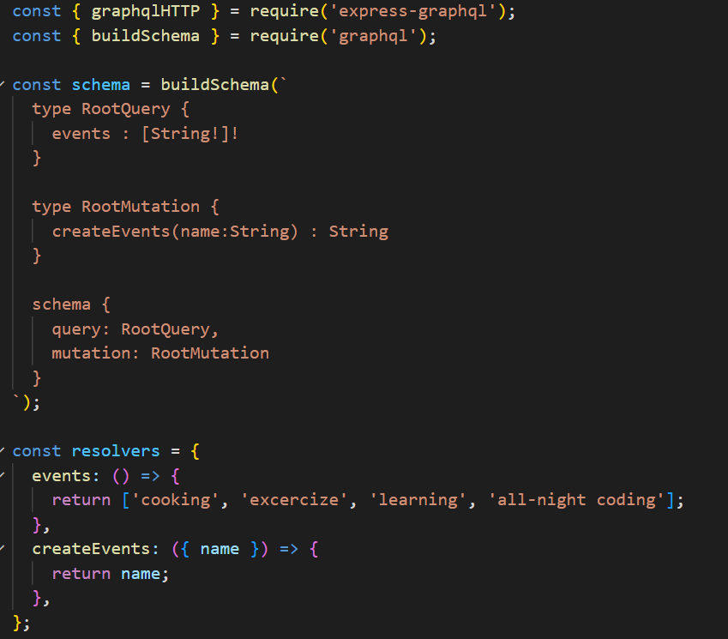
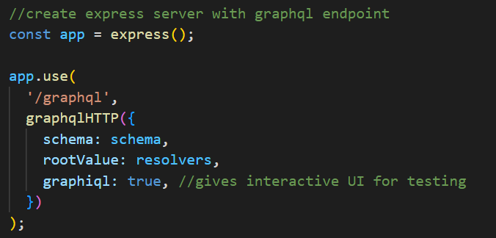
What is Schema & Resolvers
The schema describes the types of data available in your API and how clients can access or modify that data.
You create resolver functions for each field(hello) in your schema.
Resolvers are functions that execute the logic to fetch the data for a specific field.

Slide 10
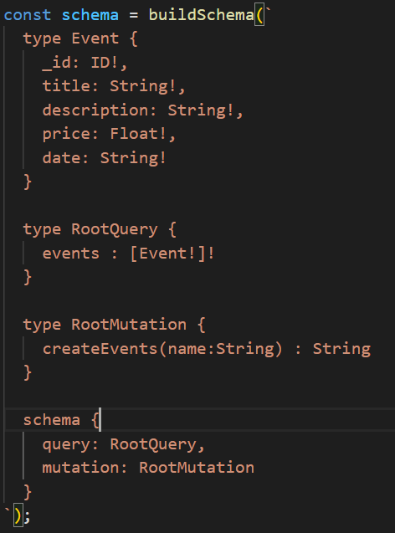
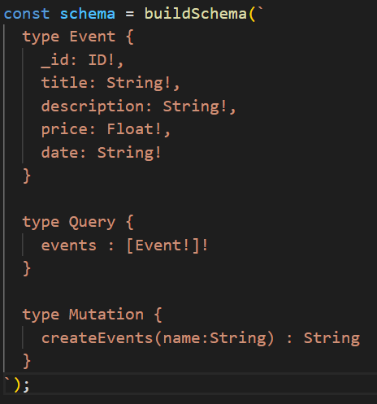
SDL(schema definition Language)
buildSchema function is used to create a GraphQL schema.
It takes a string argument which contains the GraphQL schema definition in the SDL format
It allows you to define the types available in your schema, the relationships between them, and the queries and mutations that can be performed.
a "type" is a fundamental concept used to describe the structure of data available in a GraphQL API that can be queried or mutated.
schema keyword inside buildSchema is used to define the root types (Query, Mutation, Subscription) of a GraphQL schema. These root types provide the entry points for clients to query and mutate data in the GraphQL API.
using root types provides clarity, organization, reusability to the schema, especially as the schema grows more complex.
Here root types can be defined using as shown in first img(all small letter) as second img Query & Mutation(capitalized)

Slide 11
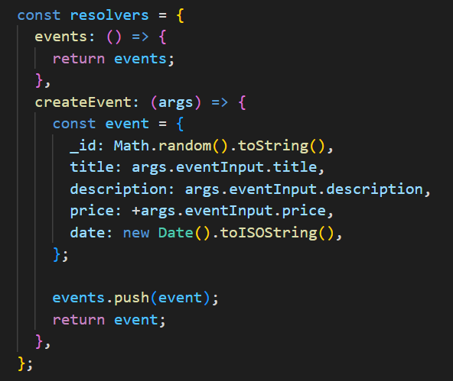
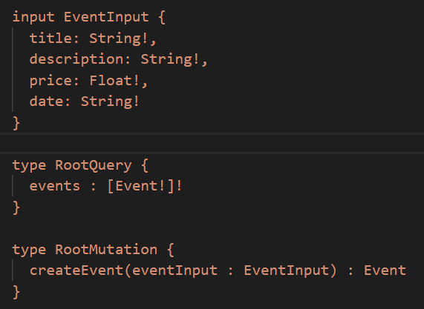
SDL(schema definition Language)
the input keyword is used to define multiple arguments as a single input object(argument) to a GraphQL field, particularly for mutations.
Now in resolvers we have to access as args.eventInput since we defined it this way in Schema Mutation type(createEvent)

Slide 12
Using Mongoose to use MongoDB
Mongoose defines the schema and models for MongoDB collections. It provides an interface to interact with MongoDB.
GraphQL defines the API schema and resolvers to fetch or mutate data.
Mongoose and GraphQL work together by using “Mongoose models” and “methods in GraphQL resolvers” to fetch or manipulate data from MongoDB collections.

Slide 13
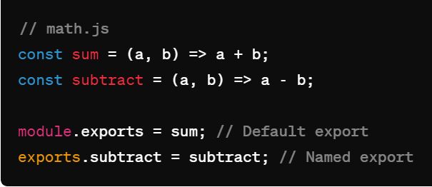
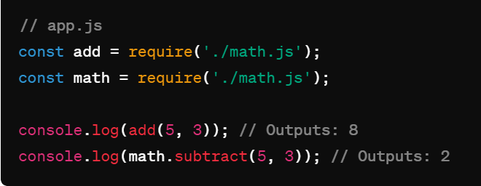
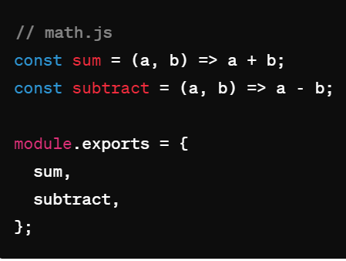
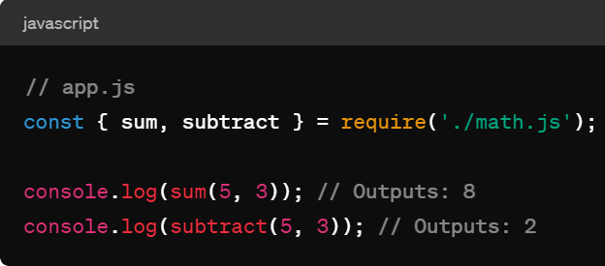
Exports in node
OR Object de-structuring
const {substract} = require('./math.js');
console.log(subtract(5, 3)); // Outputs: 2

Slide 14
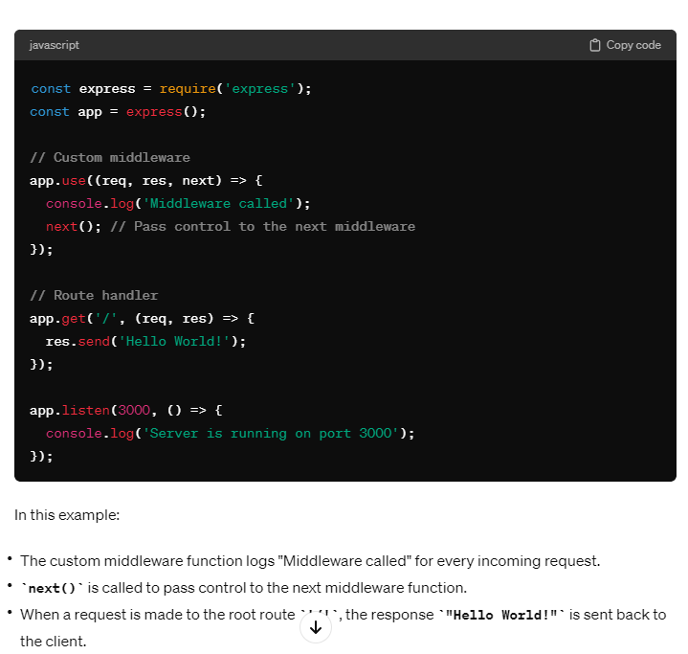
Middleware
Middleware functions are essentially the "middle" layer between a request coming into the server and the response that the server sends back. They can access request object (req), the response object (res), and the next function in the application's request-response cycle.
Middleware functions are executed sequentially in the order they are defined.
When a request is received, it passes through each middleware function until a middleware function sends a response (such as with res.send() or res.json())
If not terminated by sending a res, flow will finally reach route handler.
It provides a flexible way to handle common tasks such as logging, authentication, error handling, and more.

Slide 15
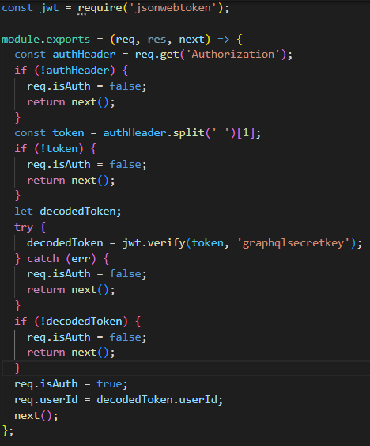
Imp notes about next() in middleware
The code after next() in the current middleware continues to execute only after the next middleware has completed its execution.
So, it’s imp to use return keyword for conditional flow
If next() is not called in a middleware function, it will effectively end the request-response cycle and prevent Express from moving on to the next middleware or route handler in the stack.

Slide 16
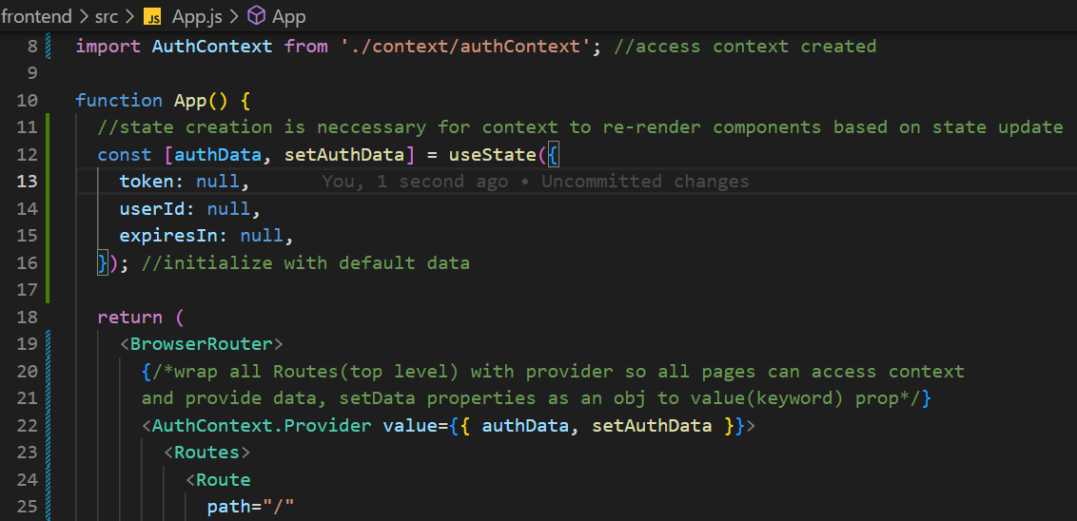
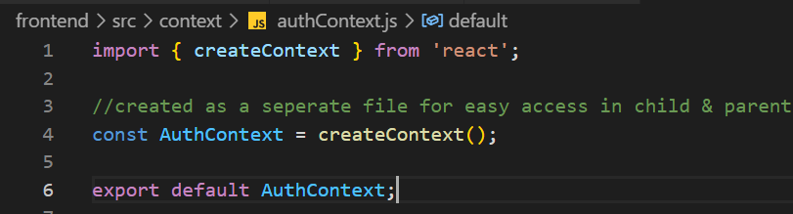
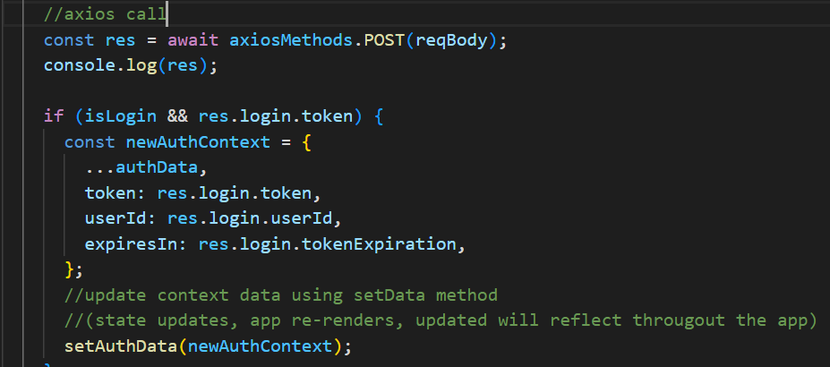
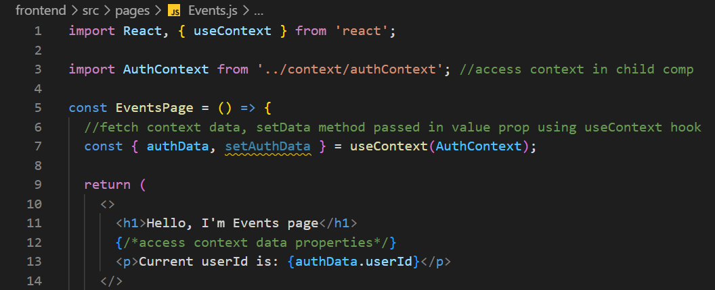
useContext, createContext read comments

